Slide 1
Tree Limbing and Harvesting ROV
Team 15 Members:
Alex Glazer, Donald Phillips, Christopher Ruiz

Slide 2





Team Introductions
Nestor Rigaud
ME DESIGN
Christopher Ruiz
TEAM LEADER
Ryan Gaylord
LEAD
COMMUNICAITONS
Alex Glazer
ME PROGRAMMING
Allen Phillips
FINANCIAL ADVISOR

Slide 3
Project Summary
What?
  Design a remotely operated vehicle (ROV) that climbs and harvests trees
Why?
  Trees can cause home and property damage
  Maximize user safety
How?
  Design an efficient and safe ROV modeled after a total tree harvester

Slide 4
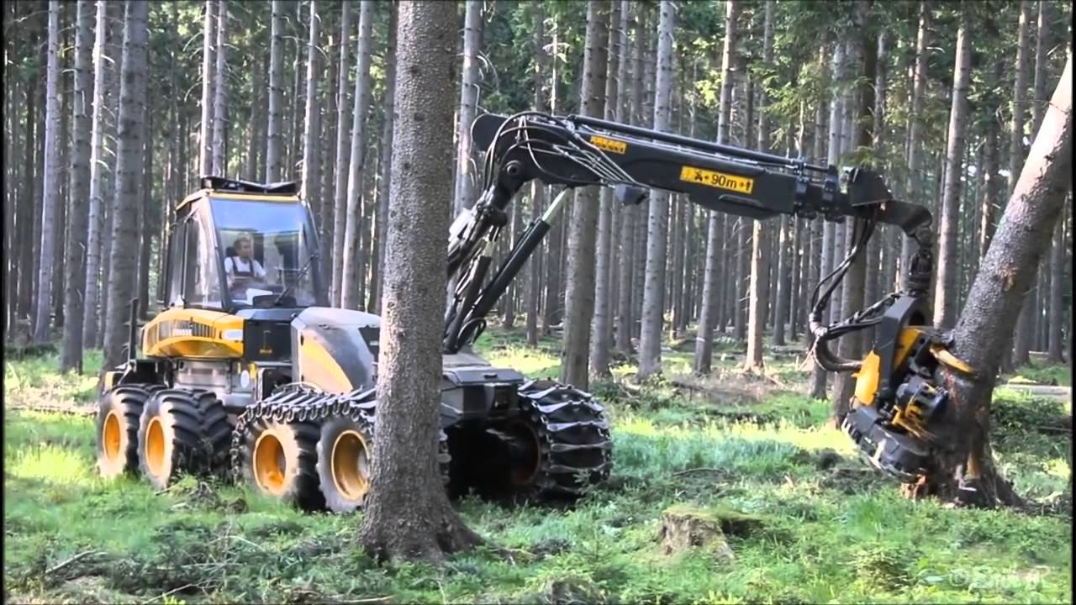
Tree Harvesting
Timber is one of the oldest known industries.
Today we use human operated machines for harvesting trees.
These machines are known as Total Tree Harvesters.
Figure 1. A Total Tree Harvester cutting down a tree [1]
Notes:
https://www.youtube.com/watch?v=soLjGPknv2o

Slide 5
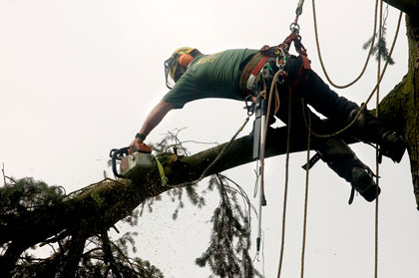
Tree Harvesting
Current tree harvesting methods have risk of human injury.
Workers in the lumber industry have a 3 times higher fatality rate than the average U.S. worker [2].
Dead trees are dangerous to climb and harvest.
Figure 2. Example of hazardous working conditions of tree harvesting [3]
Notes:
http://www.martinwood.org.uk/

Slide 6
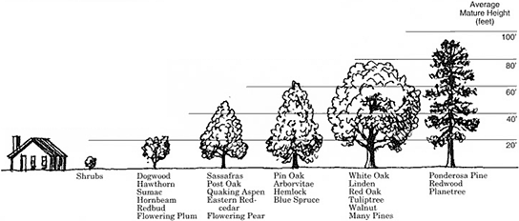
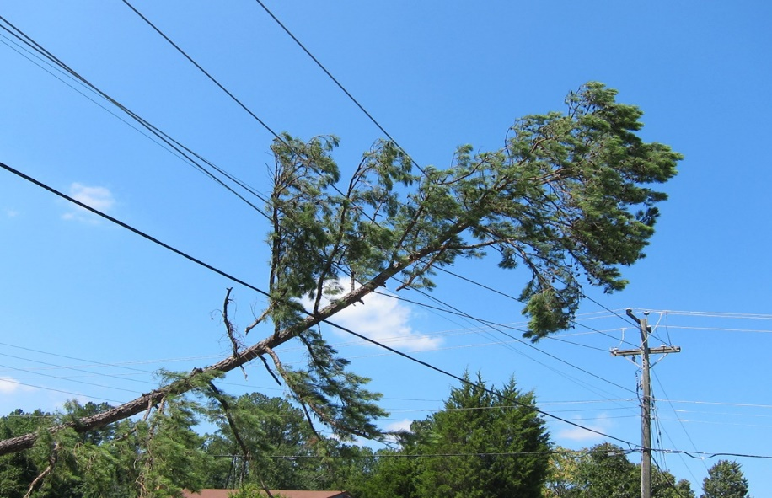
Tree Harvesting
Main factor of cost for tree removal is Height.
Cost of tree removal based on height:
  Small trees (30 ft. and under)
    $125 to $437
  Medium trees (30 to 60 ft.)
    $175 to $900
  Large trees (60 to 80 ft.)
    $400 to $1000
  Very large trees (80 to 100 ft.)
    $962 to $1400 [4]
Figure 3. Example of different tree heights [5]
Figure 4. A large tree hanging from a power line[6]
Notes:
https://www.homeadvisor.com/cost/lawn-and-garden/tree-removal/
https://www.arborday.org/trees/tips/graphics/tree-height.png

Slide 7
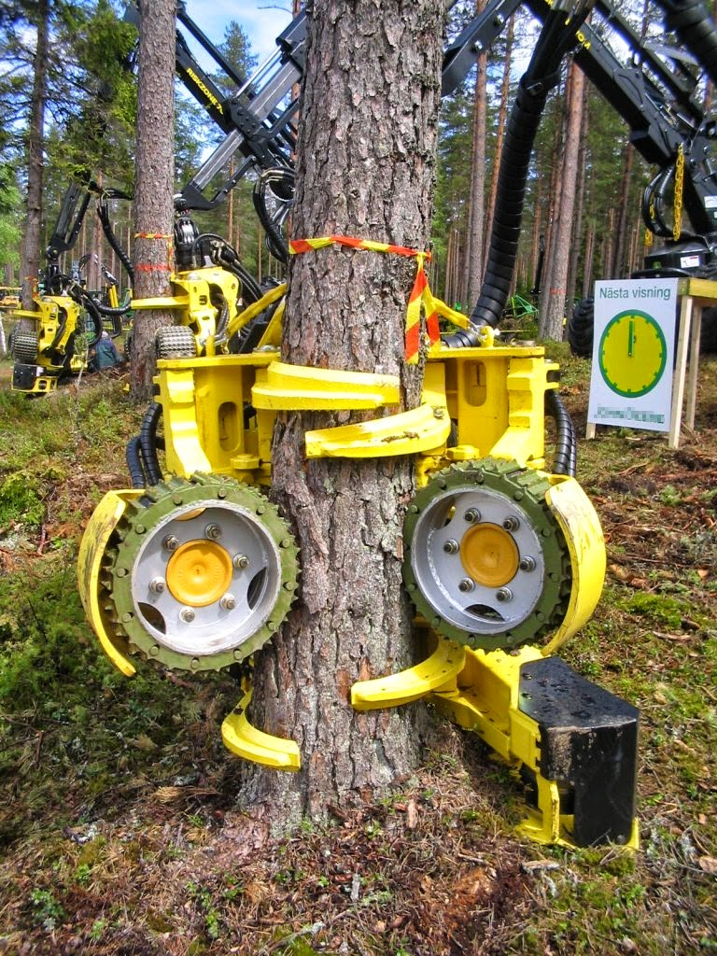
Project Scope
Design a ROV modeled after a Total Tree Harvester head
As the ROV climbs, it will de-limb the tree.
Once at a certain height, the ROV will top the tree.
As its descending, the ROV will section the tree.
The target market for our project is primarily landscaping and private rental
Figure 3. Picture of a Tree Harvester head [7]
Notes:
http://exploremachines.blogspot.com/2015/03/

Slide 8
Project Scope
Key Goals:
Climb a tree
Remove limbs
Attach to a power supply
Cut off sections of tree
Remotely controlled by user
Portable

Slide 9
Project Scope
Assumptions
Un-deformed straight tree
User is capable of using the controls for ROV
Tree can withstand weight of ROV
Ideal weather conditions when operating
User is capable of handling the machine

Slide 10
Customer Needs
Question | Customer Statement | Interpreted Need
Operation | I want this to be remotely controlled by user | The controller is able to move the harvester up and down, open and close, and saw
 | I want this to be portable | Design to be light-weight
 | I don’t want a bunch of wires from the ROV | Radio over electric over hydraulic controls
 | I want the source of power to come from a generator, not a battery | The ROV will be powered by an external source

Slide 11
Customer Needs
Question | Customer Statement | Interpreted Need
Operation | I want this to be remotely controlled by user | The controller is able to move the harvester up and down, open and close, and saw
 | I want this to be portable | Design to be light-weight
 | I don’t want a bunch of wires from the ROV | Radio over electric over hydraulic controls
 | I want the source of power to come from a generator, not a battery | The ROV will be powered by an external source

Slide 12
Customer Needs
Question | Customer Statement | Interpreted Need
Operation | I want this to be remotely controlled by user | The controller is able to move the harvester up and down, open and close, and saw
 | I want this to be portable | Design to be light-weight
 | I don’t want a bunch of wires from the ROV | Radio over electric over hydraulic controls
 | I want the source of power to come from a generator, not a battery | The ROV will be powered by an external source

Slide 13
Customer Needs
Question | Customer Statement | Interpreted Need
Operation | I want this to be remotely controlled by user | The controller is able to move the harvester up and down, open and close, and saw
 | I want this to be portable | Design to be light-weight
 | I don’t want a bunch of wires from the ROV | Radio over electric over hydraulic controls
 | I want the source of power to come from a generator, not a battery | The ROV will be powered by an external source

Slide 14
Customer Needs (cont.)
Question | Customer Statement | Interpreted Need
Safety | When cutting the sections of the tree off, they must not hit ROV on its downfall | ROV will cut tree to avoid the machine
 | I want the user to have enough chord to back up to a safe distance and climb a 60 ft. tree | 100 ft. or more of chord to ensure safety for the user
Machine Functions | I want the ROV to remain secured on the tree as it climbs up and down | The ROV adjusts its grip as the tree diameter changes
Notes:
We were not sure how to split up the table so that it can be visible to everyone on one slide

Slide 15
Customer Needs (cont.)
Question | Customer Statement | Interpreted Need
Safety | When cutting the sections of the tree off, they must not hit ROV on its downfall | ROV will cut tree to avoid the machine
 | I want the user to have enough cord to back up to a safe distance and climb a 60 ft. tree | 100 ft. or more of cord to ensure safety for the user
Machine Functions | I want the ROV to remain secured on the tree as it climbs up and down | The ROV adjusts its grip as the tree diameter changes
Notes:
We were not sure how to split up the table so that it can be visible to everyone on one slide

Slide 16
Customer Needs (cont.)
Question | Customer Statement | Interpreted Need
Safety | When cutting the sections of the tree off, they must not hit ROV on its downfall | ROV will cut tree to avoid the machine
 | I want the user to have enough chord to back up to a safe distance and climb a 60 ft. tree | 100 ft. or more of chord to ensure safety for the user
Machine Functions | I want the ROV to remain secured on the tree as it climbs up and down | The ROV adjusts its grip as the tree diameter changes
Notes:
We were not sure how to split up the table so that it can be visible to everyone on one slide

Slide 17
Functional Decomposition
ROV
Remove limbs
Remove sections of tree
Secure to tree
Channel up tree

Slide 18
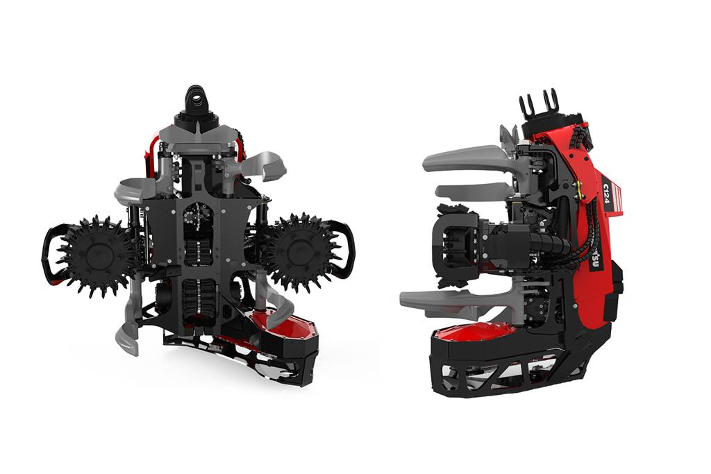
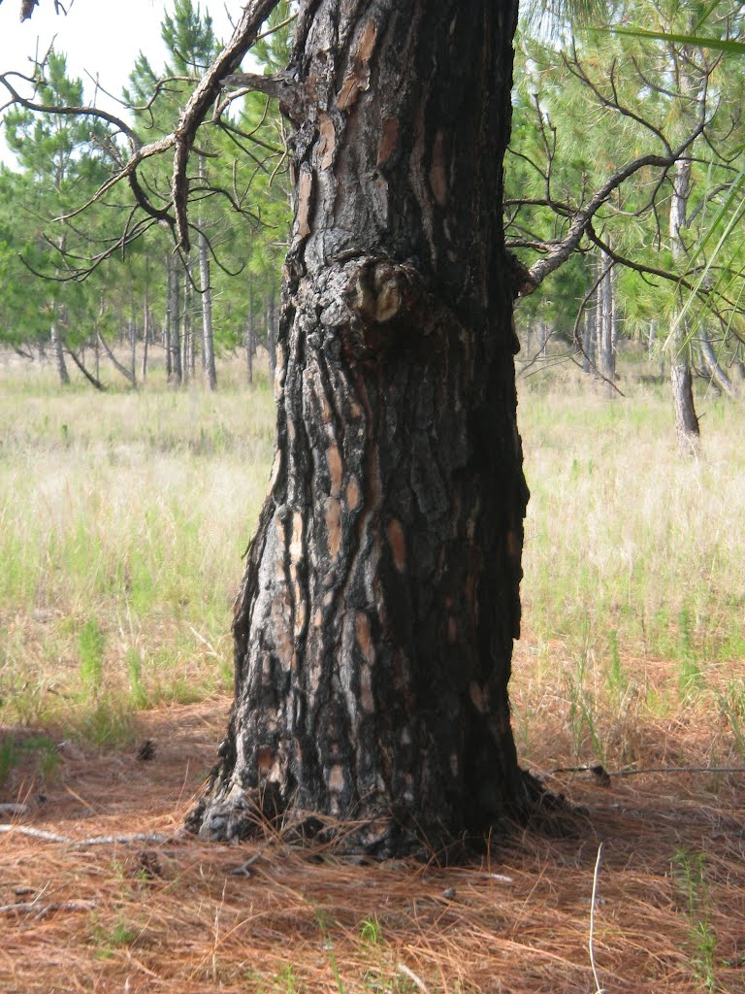
Functional Decomposition
Secure to tree

Slide 19
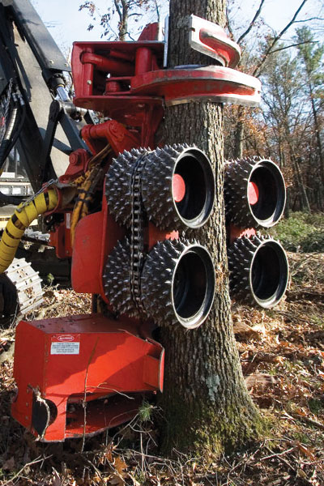
Functional Decomposition
Channel up tree

Slide 20
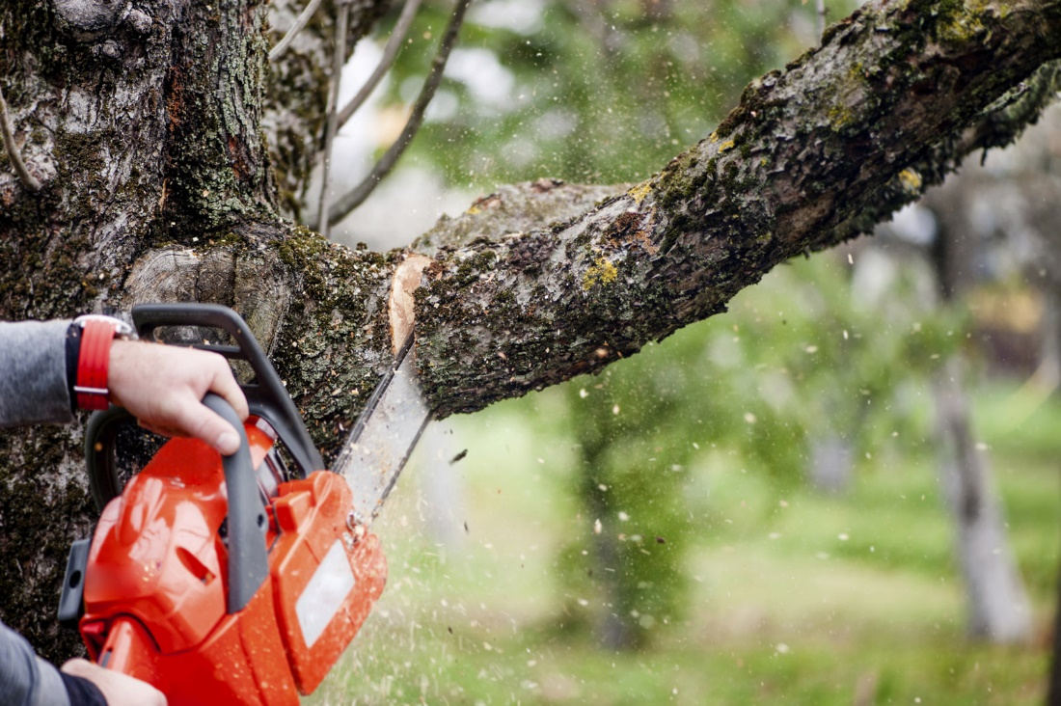
Functional Decomposition
Remove limbs

Slide 21
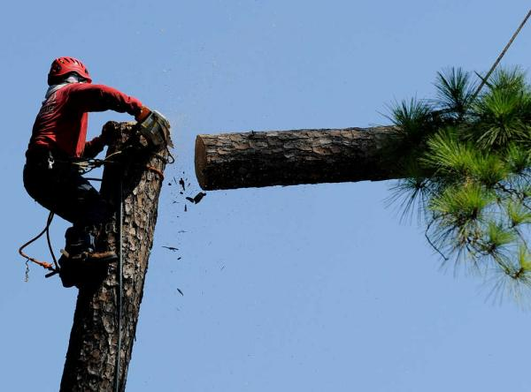
Functional Decomposition
Remove sections of tree

Slide 22
Tree Harvesting ROV
The Next
Step?

Slide 23
The Next Step
Target Data
  Based off the customer needs and the functional decomposition.
  Will be used to create a Target Catalog and a Target Summary
Concept Generations
  Brainstorming ideas on how to design the tree sectioning ROV.
Project Plan

Slide 24
Tree Harvesting ROV
Back-up
Slides

Slide 25
Back-up Slides
How does targeting the landscape market and private renting make this process more efficient, safe, and cost effective?
  The ROV can section the tree faster than a person climbing it.
  Eliminates the risk of having a person climbing up the tree. (Dead Trees)
  Avoids having to pay hazard fee.

Slide 26
Back-up Slides
Why would a person with trees around their property want to rent this machine?
  Falling trees can cause property and home damage.
  Insurance companies normally will not help pay for damages caused by maintenance related issues [13].

Slide 27
Back-up Slides
What are other factors that affect cost of tree removal?
  Conditions
    Dead trees can be hazardous to remove.
  Diameter
    Thicker trees are harder to cut through.
  Location
    Surrounding structures and power lines raise the price of removing a tree [4].

Slide 28
References
[1] J. (2013, August 11). Ponsse Ergo 8w Harvester im Starkholz. Retrieved October 15, 2017, from http://www.youtube.com/watch?v=soLjGPknv2o
[2] United States, Congress, Bureau of Labor Statistics. “NATIONAL CENSUS OF FATAL OCCUPATIONAL INJURIES IN 2015.” NATIONAL CENSUS OF FATAL OCCUPATIONAL INJURIES IN 2015, Bureau of Labor Statistics, 2015, p. 4.[3] Welcome We work across the Welsh Marches in Powys, Shropshire and North Herefordshire. (n.d.). Retrieved October 15, 2017, from http://www.martinwood.org.uk/.
[4] Learn how much it costs to Remove a Tree. (n.d.). Retrieved October 15, 2017, from https://www.homeadvisor.com/cost/lawn-and-garden/tree-removal/
[5] Finding a Tree. (n.d.). Retrieved October 15, 2017, from https://www.arborday.org/trees/tips/finding-a-tree.cfm
[6] Irene Bit Me! I’m just one of nearly 5 million. (2011, August 30). Retrieved October 15, 2017, from https://ridingwiththetopdown.wordpress.com/2011/08/30/irene-bit-me-im-just-one-of-nearly-5-million/
[7] A. (1970, January 01). ExploreMachines. Retrieved October 15, 2017, from http://exploremachines.blogspot.com/2015/03/
[8] Komatsu C124 harvesting head. (n.d.). Retrieved October 15, 2017, from https://www.komatsuforest.com/Products/Our-Harvester-heads/C124
[9] Burnt Pine Tree Trunk. (n.d.). Retrieved October 15, 2017, from http://www.panoramio.com/photo/69314359
[10] Harvesting and Processing Heads. (n.d.). Retrieved October 15, 2017, from https://www.woodbusiness.ca/harvesting/harvesting-and-processing-heads
[11] Celtic Tree Services LLC | Tree Service Darien, CT | Fairfield, Trumbull, New Canaan, CT. (n.d.). Retrieved October 15, 2017, from http://www.celtictreeservice.net/
[12] Home | Flowers Tree Service - Florence, SC. (n.d.). Retrieved October 15, 2017, from http://www.flowerstreeservice.com/
[13] If a Tree Falls on My House, Does Homeowners Insurance Cover It? (n.d.). Retrieved October 15, 2017, from https://www.allstate.com/tools-and-resources/home-insurance/home-insurance-tree-falls-on-house.aspx

